Slide 1

STOCK MARKET analysis dashboard
Team Members
Ipsita Puhan
Shraddha Chandole
Pyarla Vinod Kumar
Saurabh Mandlekar
Team Would Like to Thank
B Harish for Guidance throughout Project building process

Slide 2
Introduction
The stock market plays a crucial role in the economy by enabling companies to raise capital and providing investors opportunities to generate returns.
Stock market analysis involves examining price movements, trading trends, sector performance, and portfolio behavior to understand market dynamics and trading efficiency.
In this project, historical trading data is analyzed to evaluate profitability, risk, win–loss performance, and portfolio outcomes.
Tools such as Excel, SQL, Power BI, and Tableau are used to clean, analyze, and visualize stock market data, converting raw data into actionable business insights.

Slide 3
Project Overview
Excel
Collected raw stock market trading data and performed data cleaning and validation.
Conducted initial analysis using Pivot Tables and charts to understand trends, volumes, and profitability.
MySQL
Designed and created database tables for trades, companies, portfolios, and traders.
Used SQL queries to perform joins, aggregations, KPI calculations, and profit & win–loss analysis.
Power BI
Built a data model and developed an interactive dashboard with key KPIs such as total trades, profit, investment, and win rate.
Implemented slicers and filters for dynamic analysis by company, month, portfolio, and trade result.
Tableau
Created interactive visualizations to analyze portfolio value, sector-wise market capitalization, dividend yield, and geographic trading activity.
Enabled user-driven insights through filters and drill-down capabilities.

Slide 4
Kpi list
1️⃣ Total Trades: Total number of executed trades across all portfolios.
2️⃣ Total Investment: Total buy value invested in stocks.
Formula: Σ (Buy Quantity × Buy Price)
3️⃣ Total Sell Value: Total value realized from selling stocks.
Formula: Σ (Sell Quantity × Sell Price)
4️⃣ Realized Profit / Loss: Profit earned from completed trades.
Formula: Total Sell Value − Total Investment
5️⃣ Net Profit After Fees: Profit after deducting brokerage and transaction charges.
6️⃣ Win Rate (%): Percentage of profitable trades.
Formula: (Winning Trades ÷ Total Trades) × 100
7️⃣ Portfolio Return (%): Overall return generated on invested capital.
Formula: (Net Profit ÷ Total Investment) × 100
8️⃣ Average Daily Trading Volume: Average number of shares traded per day.

Slide 5
Journey of project
Excel
Tableau
Power Bi
SQL

Slide 6
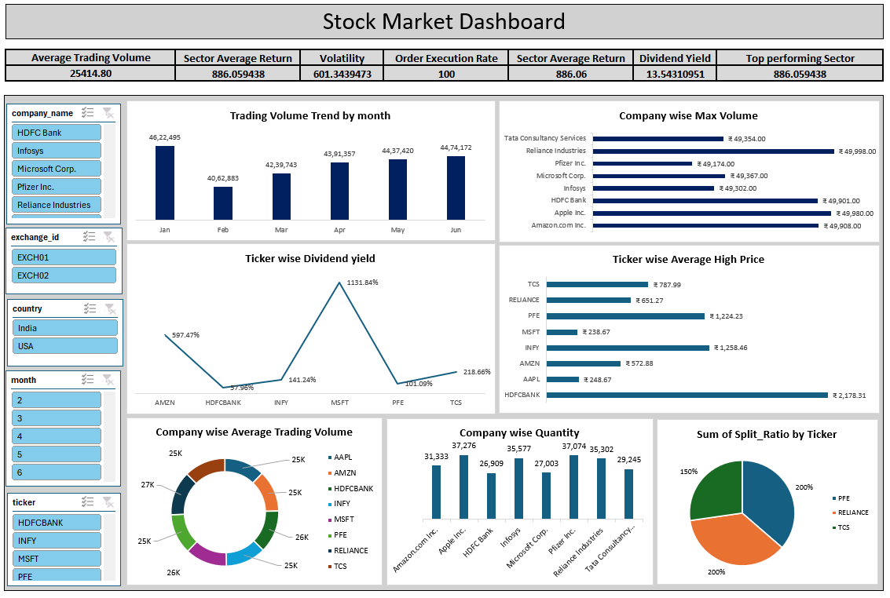
Excel Dashboard

Slide 7
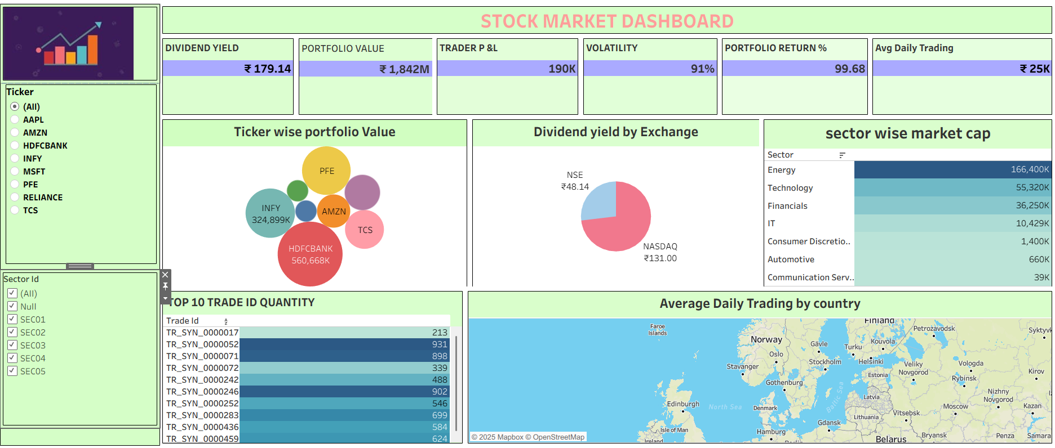
TABLEAU Dashboard

Slide 8
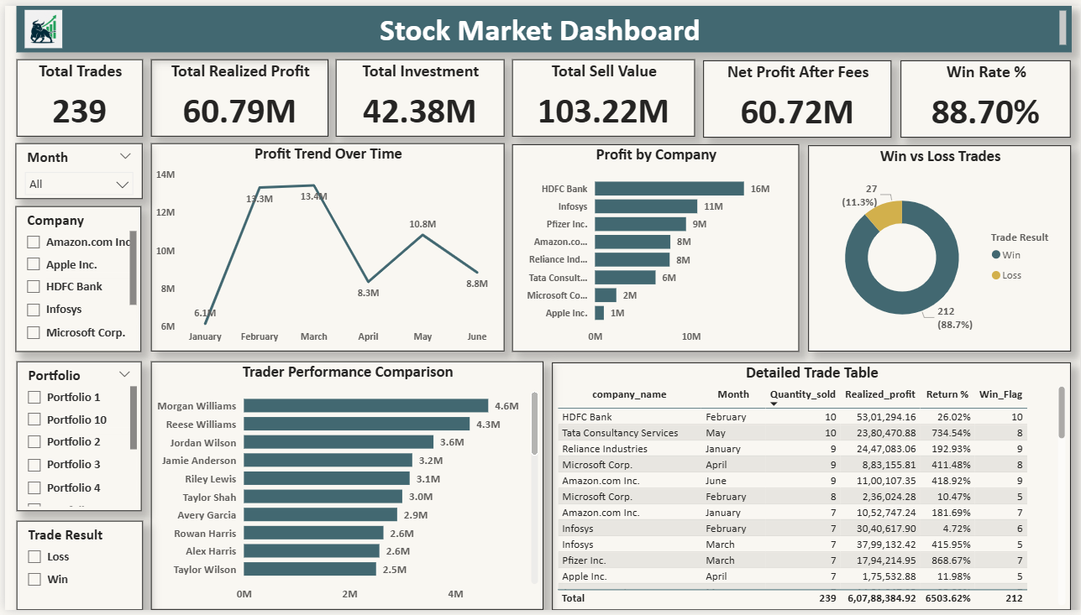
POWER BI DASHBOARD

Slide 9
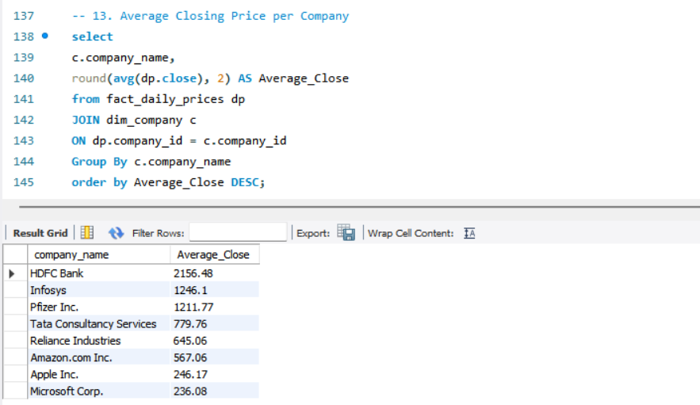
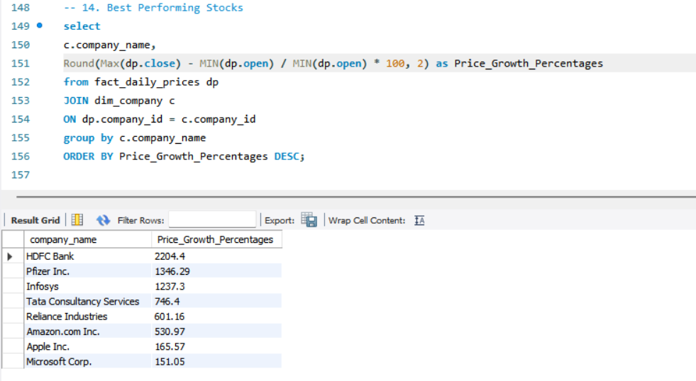
MySQL Queries

Slide 10
Conclusion
This stock market analysis provides a clear view of trading performance, profitability trends, and portfolio behavior using data-driven insights.
By integrating Excel, SQL, Power BI, and Tableau, raw trading data was successfully transformed into interactive dashboards and meaningful visual insights.
The analysis helped identify top-performing stocks, profitable traders, high-return portfolios, and overall market trends, supporting informed investment decisions.
Overall, this project demonstrates strong analytical thinking, effective use of BI tools, and the value of combining multiple technologies for accurate financial analysis.

Slide 11
Thank You

